Slide 1
Speckle reducing OCT using optical chopper
SR-OCT
Yiqiang ZHU

Slide 2
CONTENTS
1
Speckle noise introduction
2
Experimental setup and principle
3
Experiment results
4
Conclusion

Slide 3
1
Speckle noise introduction

Slide 4
1
Speckle noise introduction
Speckle noise introduction
Optical coherence tomography (OCT) is a fast-developing biomedical imaging technology in recent years. It has many advantages.
Unfortunately, the signal to noise ratio (SNR) of OCT is seriously affected by the speckle noise which is inherent in all coherent imaging approaches, especially for a turbid target such as biological tissue.
Furthermore, the loss of contrast and resolution of image details reduces the clinical diagnosis ability of OCT.
D. Huang, E. A. Swanson, C. P. Lin, J. S. Schuman, W. G. Stinson, W. Chang, M. R. Hee, T. Flotte, K. Gregory, C. A. Puliafito, and J. G. Fujimoto, “Optical coherence tomography,” Science 254(5035), 1178–1181 (1991).

Slide 5
1
Speckle noise introduction
Speckle reduction technology for OCT
spatial wavelet filtering
disadvantage:
degrading spatial resolution
Through a series of algorithms
Software based
fractional Fourier transform
…...
the 4f imaging system with a scattering disk
①capturing a number of images(uncorrelated speckle patterns) ②averaging
disadvantage: need ①high stability ②complicated configurations
Hardware based
multi-channel joint aperture detection system
…...

Slide 6
2
Experimental setup and principle

Slide 7
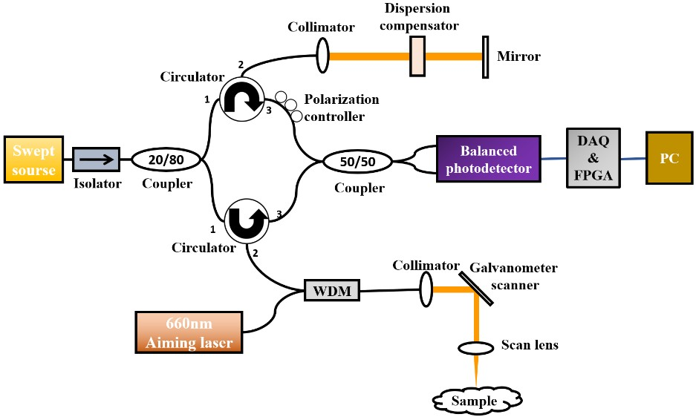
2
Experimental setup and principle
Experimental setup
The swept laser engine (AXP50124-17, Axsun) parameter:
parameter | Value
Center wavelength | 1300nm
Bandwidth(-10dB) | 140nm
Output Power | 22mW
Scan rate | 100kHz
This OCT system provides
an axial × transverse resolution of 13×22 µm and imaging depth of ∼5.0 mm in air.
Fig 1
Li Rui,Yin He,Hong Jiaying,Wang Chengming,He Bin,Chen Zhengyu,Li Qin,Xue Ping,Zhang Xiao. Speckle reducing OCT using optical chopper.[J]. Optics express,2020,28(3).

Slide 8
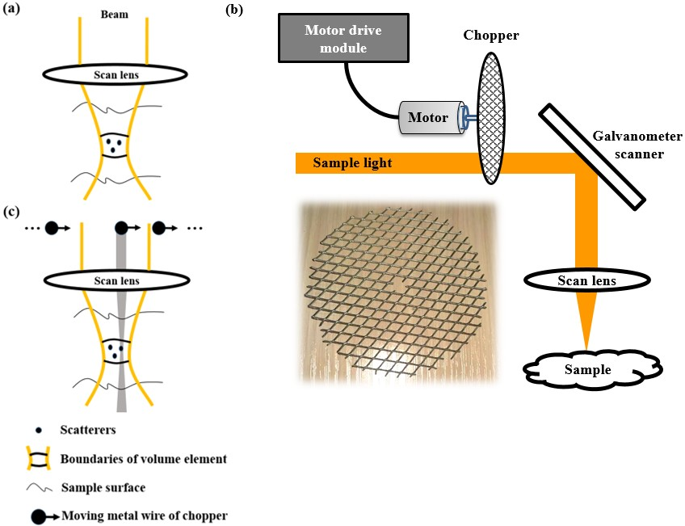
2
Experimental setup and principle
Principle
How the speckle noise is formed in OCT?
Generally, biological tissues often contain a large amount of scattering particles, i.e. scatterers. Fig. 2(a)The coherent superposition of backscattered lights from different scatterers in each volume element leads to the randomly distributed granular spots, namely speckle noise
Optical chopper parameters:
The optical chopper used in this experiment is a 0.6 mm thick and 7 cm diameter circle-shaped metal net with 4 × 8 mm diamond-shaped mesh.Fig. 2(b). The beam diameter of sample light is ∼5.6 mm.
Fig 2

Slide 9

2
Experimental setup and principle
Principle
The speed of motor
Basically, to make sure the speckle patterns are as uncorrelated as possible for neighbor frames, the moving distance of sample light on optical chopper should be longer than the diameter of sample light within a B-scan time. Therefore, the minimum rotation speed of motor $N_{min}$ is approximatively given by
F is the frame rate of OCT, L the diameter of sample light, R the distance between the center of sample light and motor shaft.
Tried 8 different speeds in the experiment.(The minimum speed that meets the formula(1))
Interestingly, the speckle reduction effect is insensitive to the rotation speed and remains almost unchanged.

Slide 10
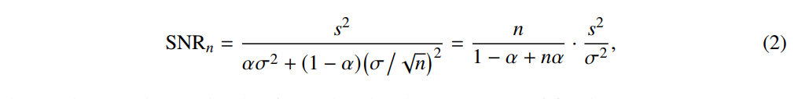
2
Experimental setup and principle
Principle
Analysis of signal to noise ratio
There are two types of speckle noises in SR-OCT images, i.e. random noise and fixed-pattern noise. When the optical chopper rotates, the former varies randomly, while the latter remains constant. Supposing the standard deviation (STD) of two speckle noises are both σ, after n-time averaging operation, the STD of random noise is $n^{−1/2}$σ, while the STD of fixed-pattern noise still remains σ. Therefore, the SNR of n-time averaged image is expressed by
s denotes the amplitude of signal and α the proportion of fixed-pattern noise in noise.
Thus the SNR of OCT image is improved by
①If α=0, the image SNR is increased by the average number n. At this time, all noise is completely uncorrelated
②If α=1, the image SNR is a constant. because the fixed-pattern noise cannot be suppressed by averaging.

Slide 11
3
Experiment results

Slide 12
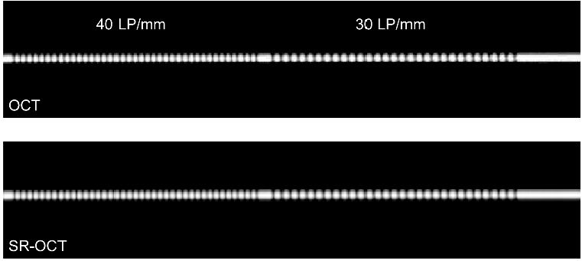
3
Experiment results
Transverse resolution
B-scans of the variable frequency gratings obtained by conventional OCT and SR-OCT
·the beam at the entrance pupil of scan lens is assumed to be Gaussian
·using a variable frequency gratings（Ronchi rulings）
·measure the transverse resolutions of conventional OCT and SR-OC
with n = 100
·the SR-OCT could work while preserving the transverse resolution.
Fig 3

Slide 13
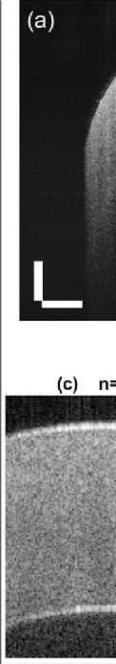
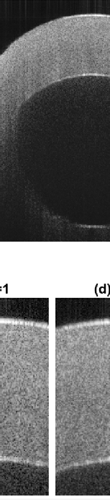
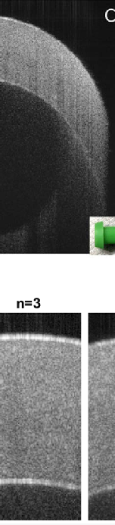
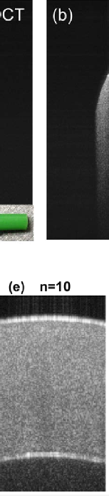
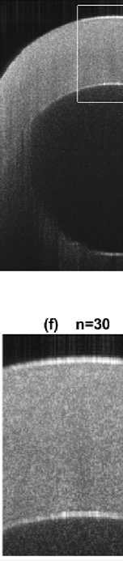
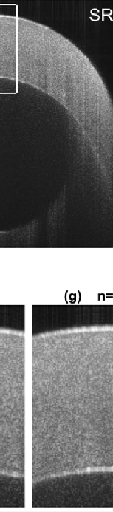

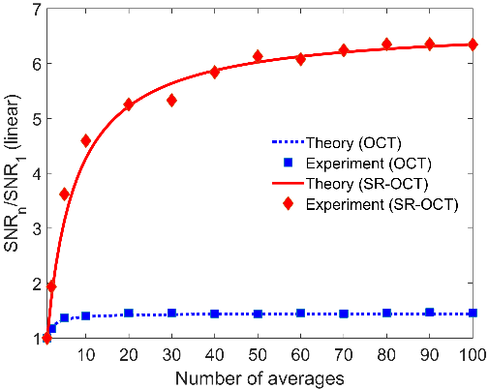
3
Experiment results
Tissue phantom
① Use conventional OCT and SR-OCT to image the plastic dust cap
The relationship of the improvement factor of SNR and n in OCT and SR-OCT
Fig 5
Fig 4

Slide 14
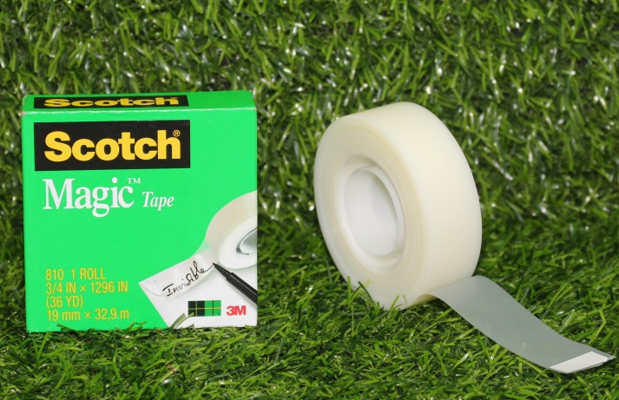
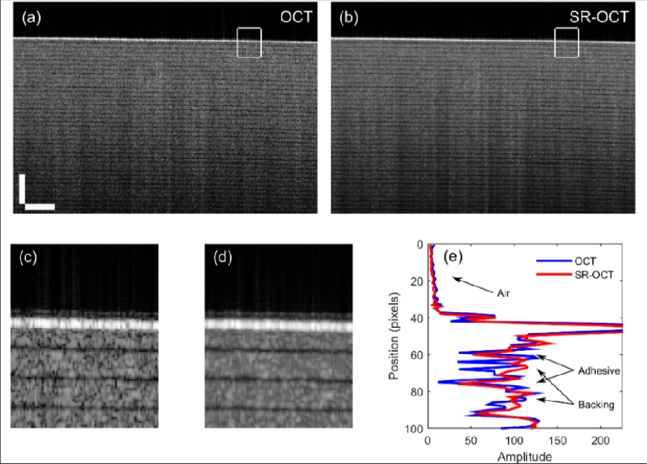
3
Experiment results
Tissue phantom
② Use conventional OCT and SR-OCT to image the tape（Scotch 810）
（a multi-layer tissue phantom）
A-scans obtained by two approaches at the same position of the tape are compared in Fig. 6(e).
Clearly，the periodic structure of tape is resolvable for SR-OCT but almost invisible for conventional OCT.
Fig 6

Slide 15
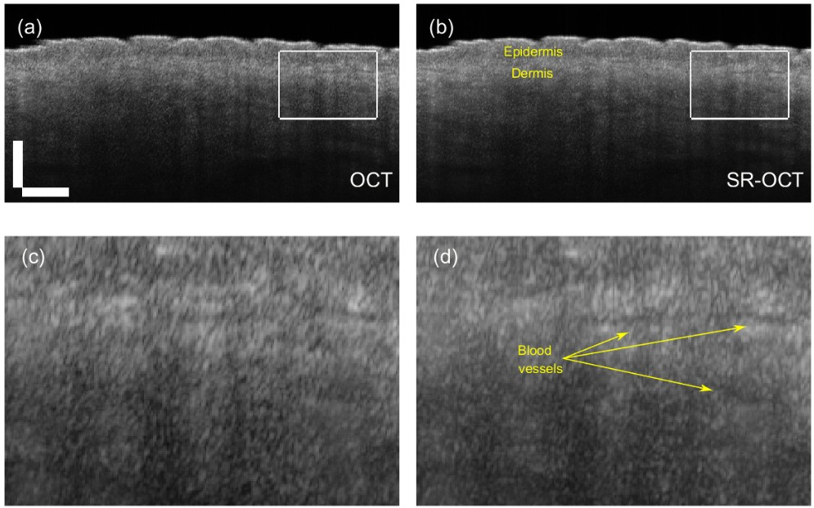
3
Experiment results
Human skin
Use conventional OCT and SR-OCT to image the human wrist skin in vivo
Fig 7

Slide 16
4
Conclusion

Slide 17
4
Conclusion
Conclusion
①an excellent speckle noise reduction without losing resolution is experimentally
achieved
②provides high quality images with low cost, simple structure and compact
interation design.
·a tradeoff between image quality and imaging speed for SR-OCT

Slide 18
Thanks for
your listenning
THANKS TO

